Slide 1

Features overview
Phani Srikar
Lead Engine Programmer

Slide 2
Intro to Razix
Razix is the Next Gen open-source engine for testing and researching AAA algorithms and designs
Features include Frame Graph, backend agnostic Rendering API (single RHI for Vulkan, D3D12, OpenGL, Metal etc.)
Mesh shaders and ReSTIR based DI + GI
Visibility buffer based bindless materials
Indirect draw as fallback system

Slide 3
FrameGraph in Razix
Inspired from EA’s FrameGraph design
https://www.gdcvault.com/play/1024612/FrameGraph-Extensible-Rendering-Architecture-in
Uses a WorldRenderer to build the passes in a single file
Easy visualization using Graphviz tools
Passes are built using C++ lambdas instead of classes
Culling of unreferenced passes/resources
External resources can be imported via Import
Doesn’t interfere with Engine Rendering API
Descriptor binding vs command buffer recording API is still the same
Single threaded as of now

Slide 4
FrameGraph - Design
Coming...

Slide 5
FrameGraph – WorldRenderer
RZWorldRenderer is responsible for building the frame graph passes
Hooking up R/W resources
Execution & Submission of commands to the GPU
Managing RTs and read/write operations from other passes
The execute function for a FrameGraphPass is responsible for rendering
The setup function is responsible for creating the resources uses in the FrameGraphPass
Every pass renders onto it’s own set of RenderTextures
Materials will have to compatible with that pass

Slide 6
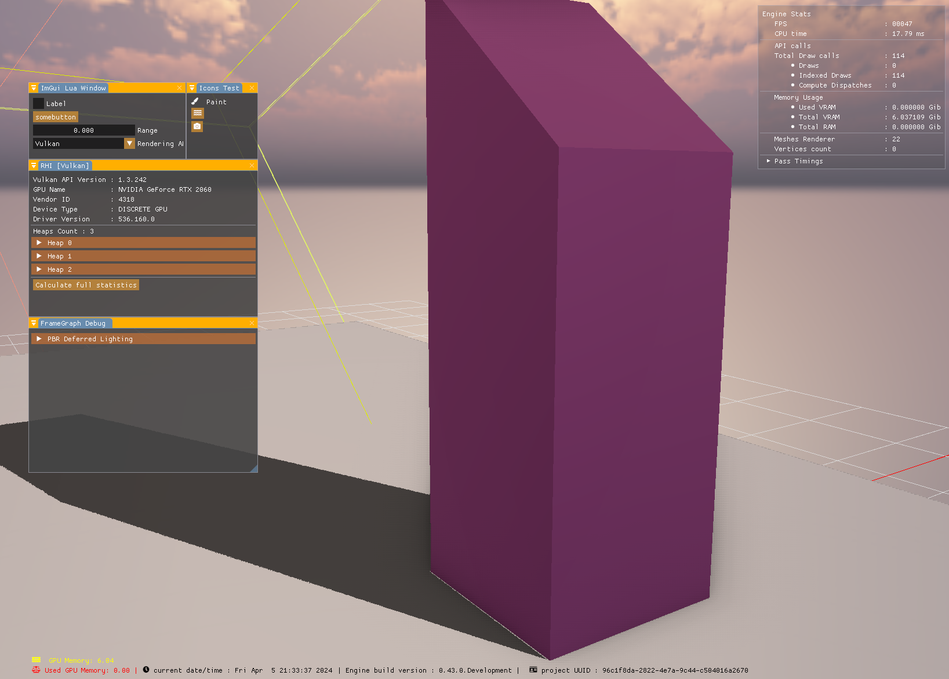
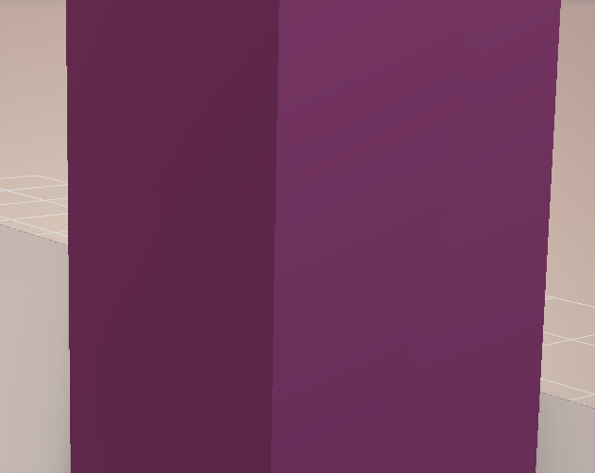
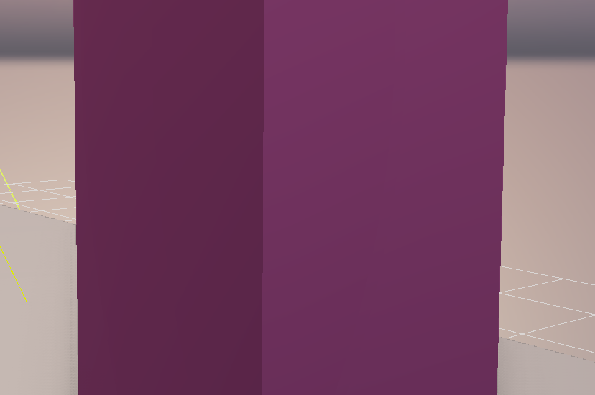
FXAA + TAA
No AA
FXAA

Slide 7
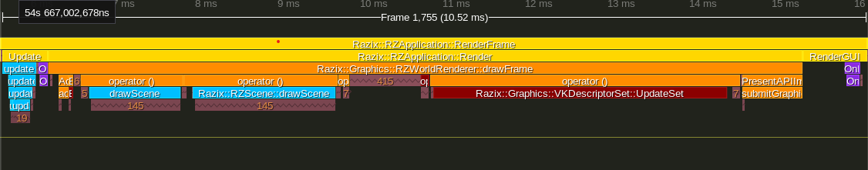
Performance Bottleneck – vkQueuePresentKHR/vkQueueSubmitKHR
Problem
Presentation of frame is taking around 1.2-2.0ms in Razix, typical native Vulkan app takes around 0.06-0.08ms (avg. < 1.0ms)
This includes time for both vkQueuePresentKHR(0.04-0.06ms) and vkWaitForFences(taking around 0.8-1.2ms)
Could be due to absence of memory and pipeline barriers for Render Targets b/w the FrameGraph passes, presentation engine is resolving the dependencies and it taking a lot of time
Or since it’s separated into many virtual functions this could be causing issues, since we have fixed no. of semaphores per frame, try implementing them in a single function inside the VKSwapchain itself to make things simple and fast and have less cache misses
Solution
Merge submission and presentation into a single function to avoid redirection that too through virtual functions
VKSwapchain will manage the frameSyncData ({imageReadySemaphore, renderingDoneSemaphore, inFlightFence} x MAX_SWAP_IMAGES(3))
Pipeline/Memory barriers will help in synchronization of pass resources and presentation only waits on VK_PIPELINE_STAGE_COLOR_ATTACHMENT_OUTPUT_BIT
Presentation is under 1.0ms
Razix Frame

